Slide 1


CVI620/ DPS920 Introduction to Computer Vision Computer Vision Problems and Methods
Seneca College

Slide 2
Overview
Machine Learning for Computer Vision
A simple computer vision problem
Features
Problems and Methods
Classification, Clustering, Regression
Supervised, Unsupervised, Semi-Supervised

Slide 3
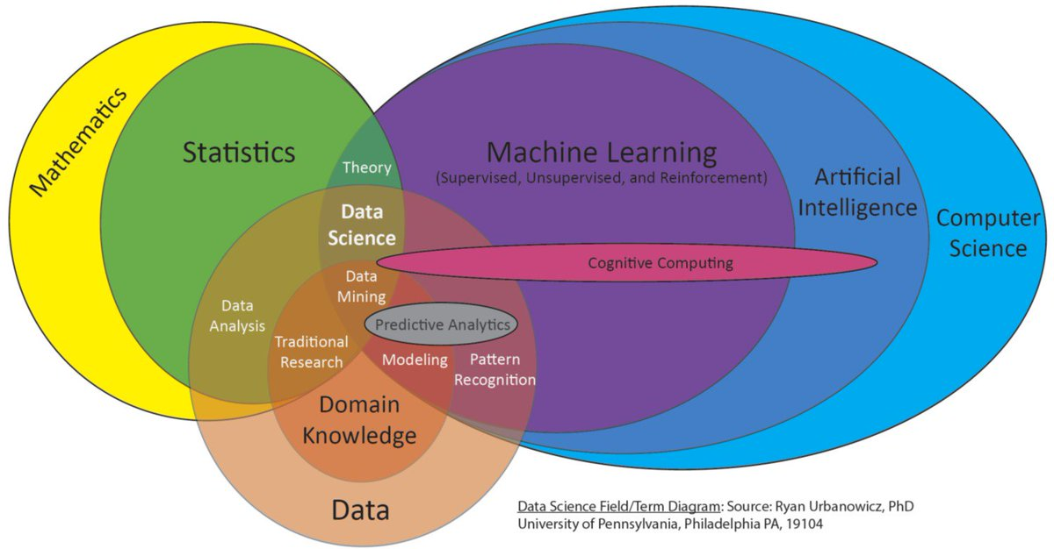
Overlaps of AI fields

Slide 4
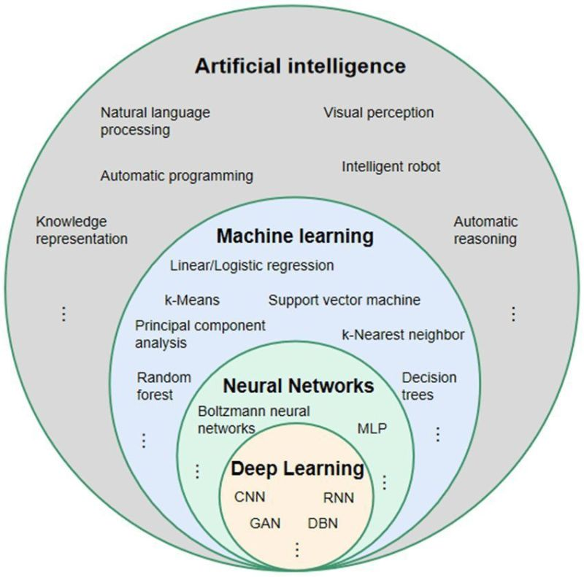

Slide 5
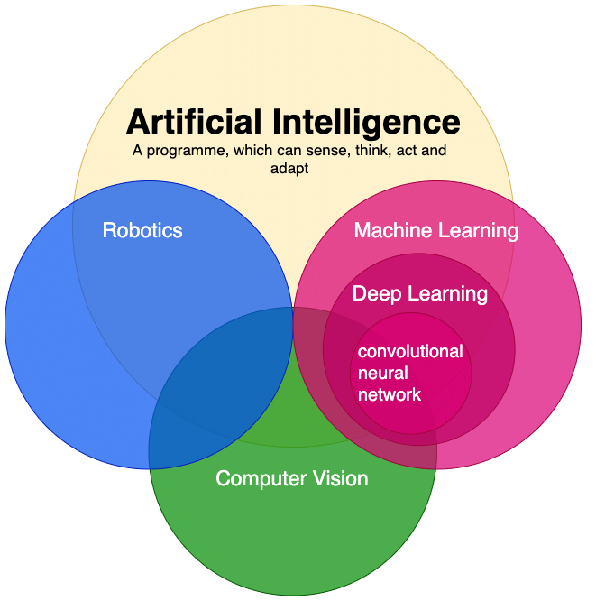
https://www.researchgate.net/figure/Relation-between-Artificial-Intelligence-Machine-Learning-and-Deep-Learning-Computer_fig1_342978934

Slide 6
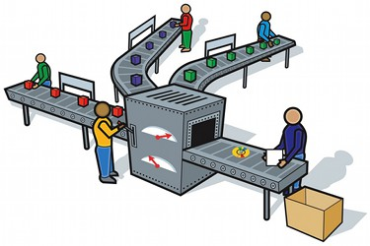
Example: Assembly Line Inspection
Design a vision system that can detect the objects on the assembly line
How can you solve this problem?
https://binged.it/2TlZFLU

Slide 7
Solving a Computer Vision Problem
Method 1: Start with intuition, implement it, use data to verify your intuition/ concept
Use color, size, shape, etc.
Method 2: Start with data, then use features and build a model to learn how to solve the problem (Machine Learning methods)
Give labelled training samples and features to a machine learning algorithm
The algorithm automatically builds a model for detection
Method 3: Start with LOTS of data and an intuition about the Neural Net architecture, train the NN to solve the problem
https://www.quora.com/What-is-the-alternative-to-machine-learning

Slide 8
Features
In Machine Learning, features are data measurements or information that can be used to predict a target value.
In computer vision, in addition to above, specific structures in images, e.g. edges, corners, etc. are also referred to as features.
https://en.wikipedia.org/wiki/Scale-invariant_feature_transform

Slide 9
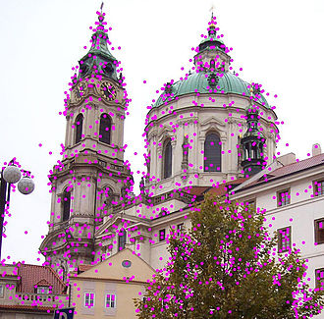
Features
In Machine Learning, features are data measurements or information that can be used to predict a target value.
In computer vision, in addition to above, specific structures in images, e.g. edges, corners, etc. are also referred to as features.
Examples of commonly used image features:
Color: e.g. color histogram (bin values)
HoG: Histogram of Oriented Gradients
SIFT: Scale-Invariant Feature Transform
Shape Features
http://cs.brown.edu/people/pfelzens/papers/lsvm-pami.pdf
https://en.wikipedia.org/wiki/Scale-invariant_feature_transform

Slide 10
Method 1 (General AI)

Slide 11
Example: Assembly Line Inspection
Design a vision system that can detect the objects on the assembly line
How can you solve this problem?
https://binged.it/2TlZFLU

Slide 12
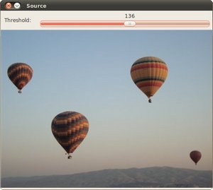
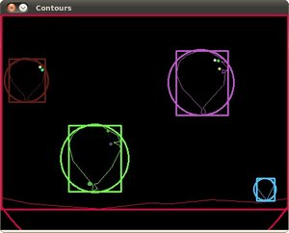

Shape Features [3]
Some features used for shape / object detection
OpenCV: Contour Features
OpenCV: Creating Bounding boxes and circles for contours
Contour Area: number of pixels in the shape / contour
Moments and Moment Invariants: you can extract useful data like area, centroid, etc
Contour Perimeter or Arc Length
Bounding Boxes and Circles for Contours: The minimum bounding box/circle for a shape is the smallest box/circle which encompasses a shape.
Elongatedness: How long the shape is: can be defined as the ratio of the region area divided by the square of its thickness

Slide 13

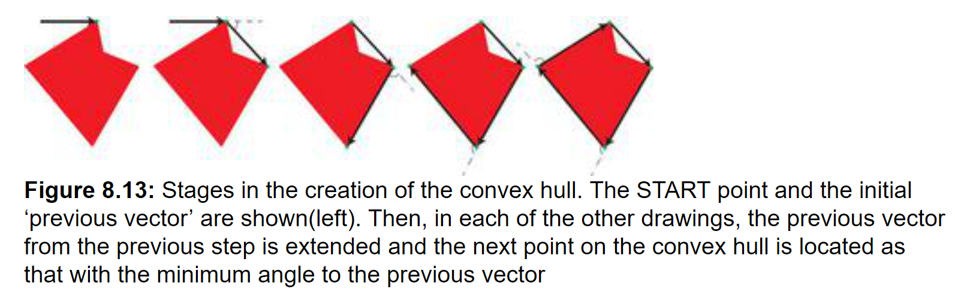
Shape Features (cont.)
Area of Convex Hull

Slide 14
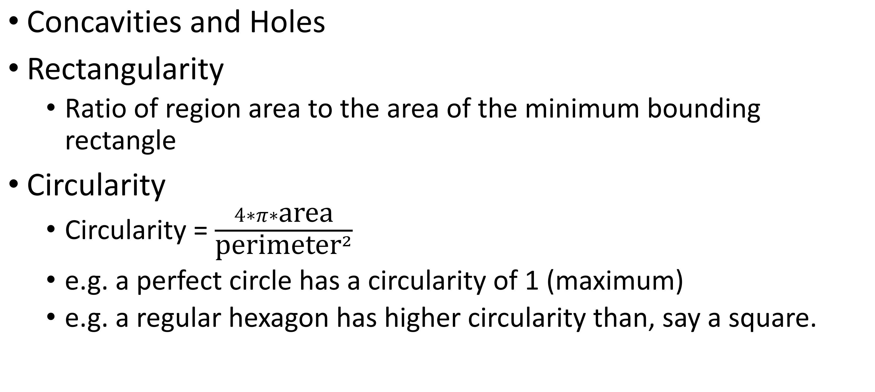
More Features
Concavities and Holes
Rectangularity
Ratio of region area to the area of the minimum bounding rectangle
Circularity
Circularity = $\frac{4∗π∗\text{area}}{{\text{perimeter}}^{2}}$
e.g. a perfect circle has a circularity of 1 (maximum)
e.g. a regular hexagon has higher circularity than, say a square.

Slide 15
Similarity or Distance
Similarity measures
Design a formula for finding the similarity between two feature vectors
For example: Correlation measures
Distance measure
Or Design a formula for finding the dissimilarity (distance) between two feature vectors
For example: Euclidean distance

Slide 16
Method 2 (ML-Based)

Slide 17
Example: Assembly Line Inspection
Design a vision system that can detect the objects on the assembly line
How can you solve this problem?
https://binged.it/2TlZFLU

Slide 18
Machine Learning - Definition
“Machine learning is a branch of artificial intelligence (AI) and computer science which focuses on the use of data and algorithms to imitate the way that humans learn, gradually improving its accuracy.”- [What is Machine Learning? | IBM]
“Solutions capable of learning directly from data without any predigestion to render it as symbols” – Mueller & Massaron
“To adapt to new circumstances and to detect and extrapolate patterns” – Russel & Norvig

Slide 19
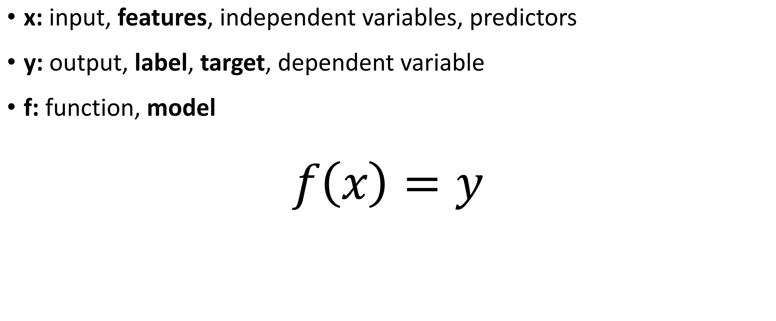
Terminology
x: input, features, independent variables, predictors
y: output, label, target, dependent variable
f: function, model
$$f\left(x\right)=y$$

Slide 20
Training or Learning a Model
Machine Learning Algorithm
Training samples: features x, and if available, labels y
f
(Model)

Slide 21

Use the Trained Model for Prediction
X
Features for a new sample
f
(Model)
$$\hat{y}$$
Prediction for label

Slide 22
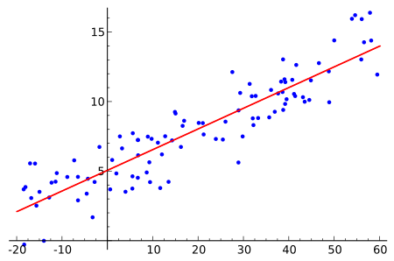
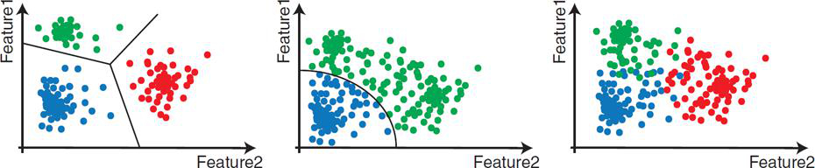
Types of Problems
Classification
Regression
Clustering
9
8
+
x
2
x
6
7
6
5
x
Y-Axis
x
+
10
4
8
x
9
3
x
2
x
x
5
7
4
1
+
x
x
1
3
0
0
1
2
3
4
5
6
7
8
X-Axis
[3] Practical introduction to Computer Vision with OpenCV
https://en.wikipedia.org/wiki/Regression_analysis
D. Abbott, Applied Predictive Analytics, Wiley, 2014
Notes:
Bus or car
Age of person in image
Type of rocks gathered from Mars

Slide 23
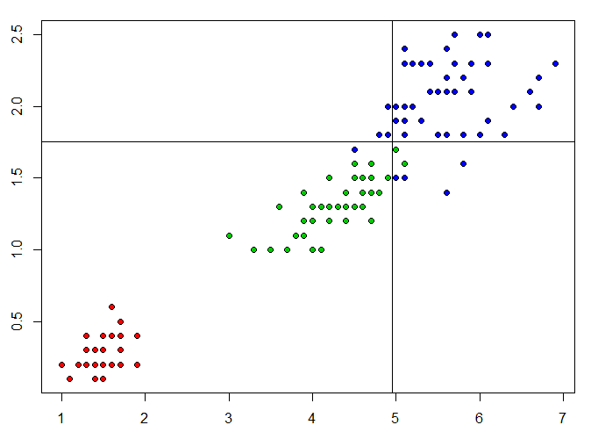
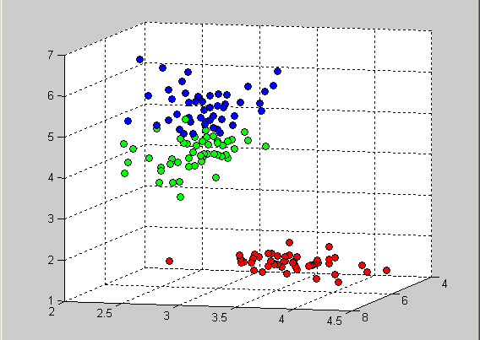
Types of Problems: (1) Classification
Predicting a discrete target value from one or more inputs
Predict whether a patient is diabetic or not, based on glucose level, weight, age
Predict the type of Iris flower given measurements on petals
Predict whether this is an image of a car or a bus

Slide 24
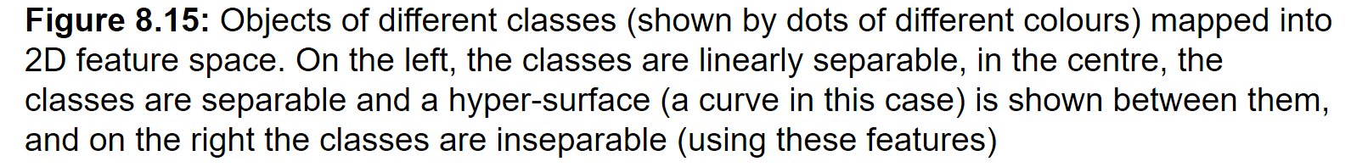
Separable classes [3]

Slide 25
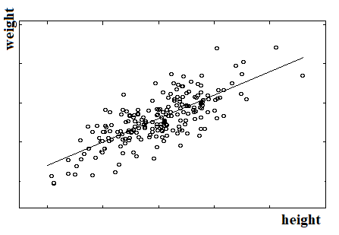
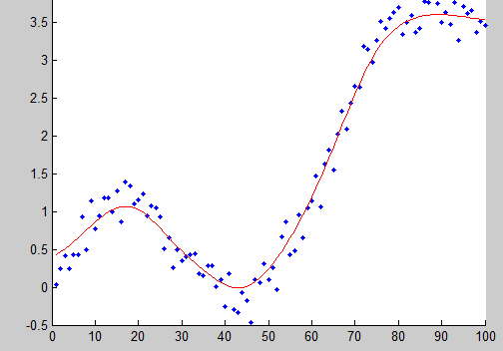
Types of Problems: (2) Regression
Predicting a continuous target value from one or more inputs
Predict weight given height
Predict the price of a used car given age, model, color, and mileage
Predict the age of the person in the image
Notes:
Go over features, vs target label for each example
Specify why continuous

Slide 26
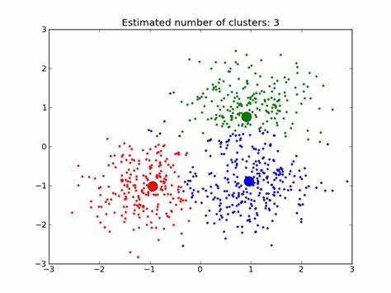
Types of Problems: (3) Clustering
Predicting groups or clusters in data (no specific target)
Looks like there are 3 types of rock samples gathered on Mars

Slide 27
Types of Models
Supervised Learning → Predictive Models
Supervised Learning
Inputs
Predictive
Model
Regression
Output
Classification
Unsupervised Learning → Descriptive Models
Unsupervised Learning
Descriptive
Model
Inputs
Clustering

Slide 28
Supervised Learning (or Training)
In supervised learning, training data contains for each sample:
Feature vector of the sample
Given class or target value of the sample
The classifier or predictor is trained based on the samples to learn the class or target value of each sample (training data)
But also be able to generalize & predict the class (or target value) of samples not seen (test data)

Slide 29
Unsupervised & Semi-Supervised Learning
Unsupervised Training
Training data consists of only the feature vectors. The class, target, or cluster for each sample is unknown.
Learn to cluster data
Semi-supervised Training
Unsupervised, but given some feedback

Slide 30
Some Well-Known Methods
Some Classifiers
K-nearest neighbor
Get votes from the closest neighbors in the feature space among training data
Logistic Regression
Decision Trees
Support Vector Machines (SVM)
Naïve Bayes
Regression
Linear
Nonlinear
Clustering
K-means

Slide 31
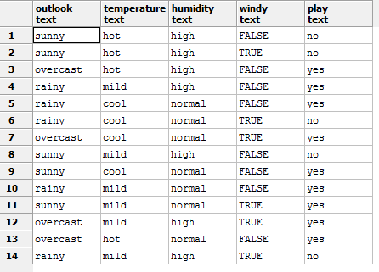
Data for ML
Tabular data
Clean, no missing data
Numerical
http://i.stack.imgur.com/XkdDl.png

Slide 32
Examples
Driver drowsiness
Initial dataset: A set of images with drowsy and non-drowsy drivers
Target: drowsy or non-drowsy (or 1 / 0)
Features: Shape features of eyes, how closed, etc.
Type: Classification
Driver drowsiness
Initial dataset: A set of videos with drowsy and non-drowsy drivers
Target: time in each video when the driver gets drowsy (if not at all, a negative number is returned)
Features: Shapes of eyes in every frame, the longest time the eye stayed closed, etc.
Type: Regression
Notes:
Methods: template matching, heuristics on distances between corners, or ML-based
Methods: Heuristics on blink duration, or ML-based

Slide 33
Examples
Traffic Sign Detection
Initial dataset: A set of images with traffic signs or no signs
Target: A label for each image indicating the sign in image (0: no sign, 1: stop sign, 2: Yield sign)
Features: ORB, SIFT, HoG, for patches in the image
Type: Classification
Motion tracking
Initial dataset: A set of videos with human motion or non-human or no motion
Target: human motion in video or not (1 / 0)
Features: motion features (e.g. optical flow)
Type: Classification

Slide 34
Examples- cont.
Cash counter
Initial dataset: A set of images of coins and paper bills
Target: total amount of money in the image
Features: size of circles, color, OCR (hard since not rectified), similarity with a set of templates, etc.
Type: Regression problem
Driver’s license detector
Initial dataset: A set of images of driver’s licenses at different angles and poses
Target: Location of card’s bounding box (x, y, w, h) – to rectify the image for OCR
Features: specs of Hough lines, color, etc.
Type: Regression?

Slide 35
Examples- cont.
Hockey player detection
A set of images of hockey rinks with players
Target: Is this patch in image a hockey player or background
Features: color, HoG, shape features, etc.
Type: classification

Slide 36
Summary
Computer Vision problems can be solved using three approaches:
Start from intuition and design a method, or
Start from data and use Machine Learning, or
Start from LOTS of data and use Deep Learning
Machine Learning problems belong to one of these types:
Regression,
Classification, or
Clustering.

Slide 37
References
[1] Computer Vision: Algorithms and Applications, R. Szeliski (http://szeliski.org/Book)
[2] Learning OpenCV 3, A. Kaehler & G. Bradski
Available online through Safari Books, Seneca libraries
https://senecacollege-primo.hosted.exlibrisgroup.com/primo-explore/fulldisplay?docid=01SENC_ALMA5153244920003226&context=L&vid=01SENC&search_scope=default_scope&tab=default_tab&lang=en_US
[3] Practical introduction to Computer Vision with OpenCV, Kenneth Dawson-Howe
Available through Seneca libraries
https://senecacollege-primo.hosted.exlibrisgroup.com/primo-explore/fulldisplay?docid=01SENC_ALMA5142810950003226&context=L&vid=01SENC&search_scope=default_scope&tab=default_tab&lang=en_US
[4] Applied Predictive Analytics: Principles and Techniques for the Professional Data Analyst, Dean Abbott

Slide 38
Readings
Chapter 10 [2]
Chapter 20 to 22 [2]
[1] A Practical Introduction to Computer Vision with OpenCV by Kenneth Dawson-Howe Available online via library.senecacollege.ca: Permalink
[2] Learning OpenCV 4 Computer Vision with Python 3 by J. Howse & J. Minichino Available online via library.senecacollege.ca: Permalink
[3] Learning OpenCV 3 by A. Kaehler & G. Bradski Available online via library.senecacollege.ca: Permalink [4] Mastering OpenCV with practical computer vision projects by D.L. Baggio et al. Available online via library.senecacollege.ca: Permalink

Slide 39

Classifier
Assign an input to one of possible classes (W₁, W₂, …, W_{R})
For example, object recognition (what’s in the image?)
Input: input pattern or feature vector (x₁, x₂, …., x_{n})
Output: class $r∈ \{1,…, R\}$
x₁
x₂
x_{n}
Classifier
.
.
.
r

